Slide 1

Fair Path Planning for Unmanned Aerial Vehicles (UAVs) in Emergency Response Missions
Germán Pardo González
Camilo Gómez
Carlos Francisco Rodríguez

Slide 2
Agenda
Motivation
Mathematical models
Objectives
Column Generation approach
Q-Learning approach
Computational experiments
Conclusions and future work

Slide 3
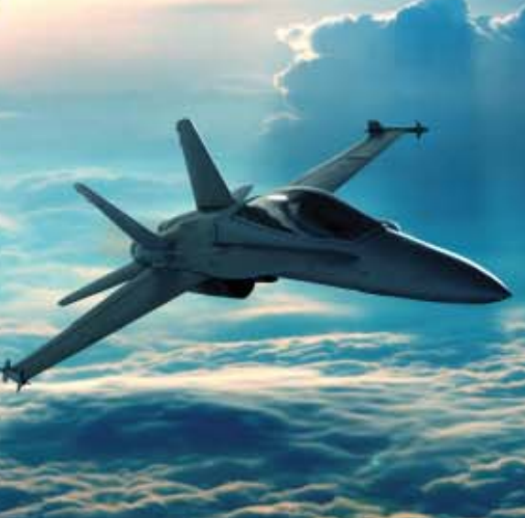
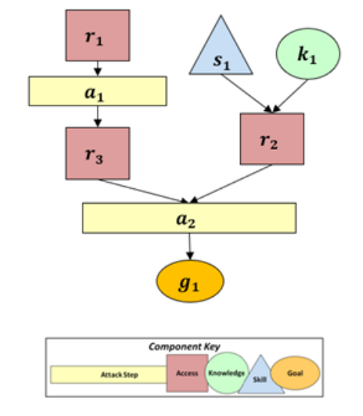
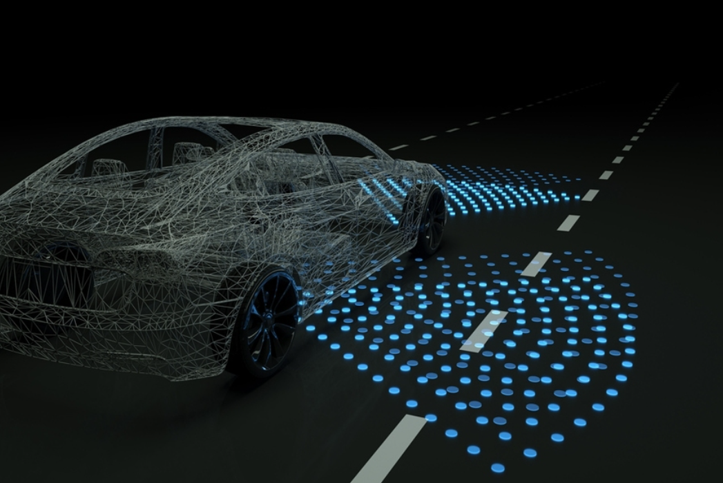
Reinforcement Learning in Cyber-Physical Systems
Modelled attacker agent using a universal optimisation framework
The solution algorithms were Q-Learning and Value Iteration as a benchmark
Juan Betancourt Osorio, Germán Pardo González, Samuel Rodriguez Gonzalez, Daniel Cuellar, Camilo Gómez, Francesco Mariotti, Leonardo Montecchi, and Paolo Lollini. 2023. Modeling attacker behavior in Cyber-Physical-Systems. In Proceedings of the 11th Latin-American Symposium on Dependable Computing (LADC '22). Association for Computing Machinery, New York, NY, USA, 117–124. https://doi.org/10.1145/3569902.3570188

Slide 4
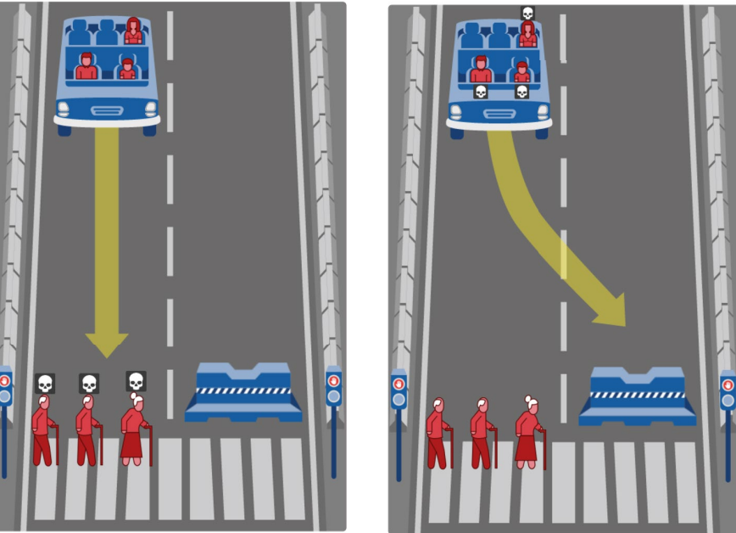
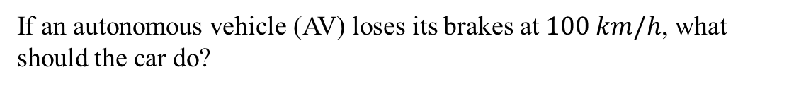
Ethical dilemmas in autonomous vehicles
If an autonomous vehicle (AV) loses its brakes at $100 km/h$, what should the car do?
Awad, E., Dsouza, S., Kim, R. et al. The Moral Machine experiment. Nature 563, 59–64 (2018). https://doi.org/10.1038/s41586-018-0637-6

Slide 5
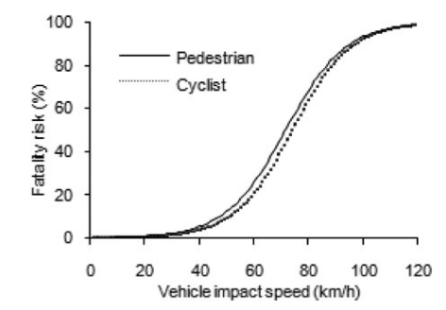
Fatality risk probability
Logistic regression to model probability of fatality
Works to quantify reward function depending on the philosophic theory
Jin Nie, Guibing Li & Jikuang Yang (2015) A Study of Fatality Risk and Head Dynamic Response of Cyclist and Pedestrian Based on Passenger Car Accident Data Analysis and Simulations, Traffic Injury Prevention, 16:1, 76-83, DOI: 10.1080/15389588.2014.881477

Slide 6
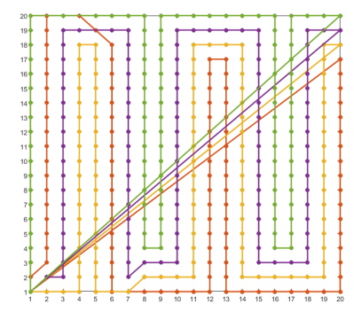

New context inspiration: UAV deployment in emergency response
Path planning using 4 different heuristics to maximise node coverage within a grid network in emergency response scenarios using UAVs
A. Anastasiou, P. Kolios, C. Panayiotou and K. Papadaki, "Swarm Path Planning for the Deployment of Drones in Emergency Response Missions," 2020 International Conference on Unmanned Aircraft Systems (ICUAS), Athens, Greece, 2020, pp. 456-465, doi: 10.1109/ICUAS48674.2020.9213876.

Slide 7
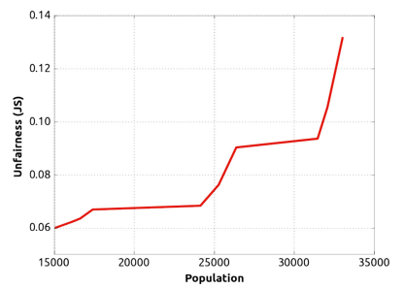
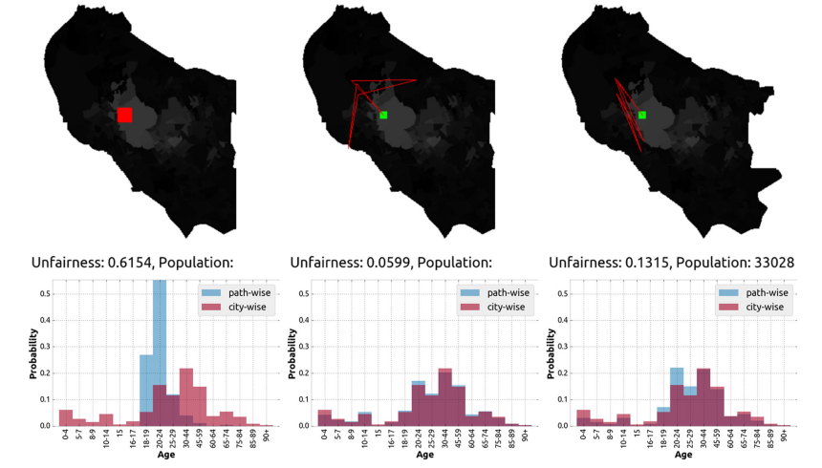
Fair navigation planning in autonomous robots
Unfairness against population coverage
Works to choose a Pareto-optimal solution between the population covered and unfairness in the initial routing planning for the drones
Martim Brandão, Marina Jirotka, Helena Webb, Paul Luff, Fair navigation planning: A resource for characterizing and designing fairness in mobile robots, Artificial Intelligence, Volume 282, 2020, 103259, ISSN 0004-3702, https://doi.org/10.1016/j.artint.2020.103259.

Slide 8
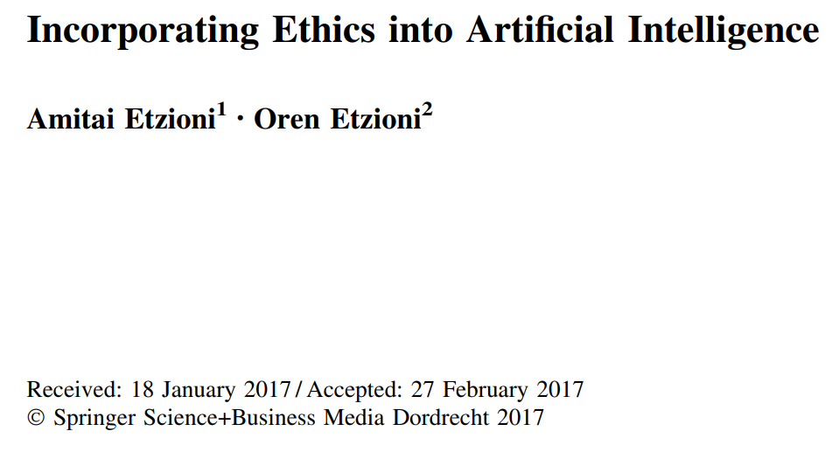
Ethics in autonomous systems?
Etzioni, A., Etzioni, O. Incorporating Ethics into Artificial Intelligence. J Ethics 21, 403–418 (2017). https://doi.org/10.1007/s10892-017-9252-2

Slide 9
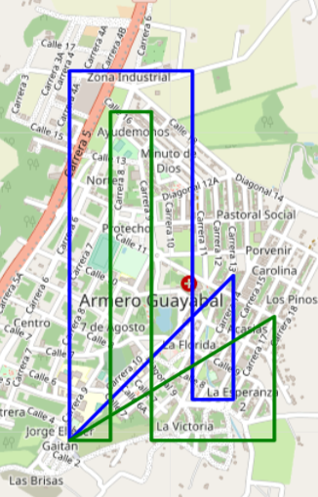
Millions of possible routes: perfect for the Column Generation method
Iterative method that provides an attractive route based on the reduced costs of the auxiliary problem (AP)
Easily connected to Pulse algorithm to dramatically accelerate subproblem’s computation time
Leonardo Lozano, Daniel Duque, Andrés L. Medaglia (2015) An Exact Algorithm for the Elementary Shortest Path Problem with Resource Constraints. Transportation Science 50(1):348-357.https://doi.org/10.1287/trsc.2014.0582
Feillet, D. A tutorial on column generation and branch-and-price for vehicle routing problems. 4OR-Q J Oper Res 8, 407–424 (2010). https://doi.org/10.1007/s10288-010-0130-z

Slide 10
Agenda
Motivation
Mathematical models
Objectives
Column Generation approach
Q-Learning approach
Computational experiments
Conclusions and future work

Slide 11
Fair routes planning
Maximise population coverage in the initial routing while ensuring fairness in a considerable amount of computation time

Slide 12
Who should the UAVs prioritise and why?
Maximise population coverage in the initial routing while ensuring fairness in a considerable amount of computation time
Tackle ethical dilemmas based on survival probability, battery time and medical resource constraints

Slide 13
Agenda
Mathematical models
Objectives
Column Generation approach
Q-Learning approach

Slide 14
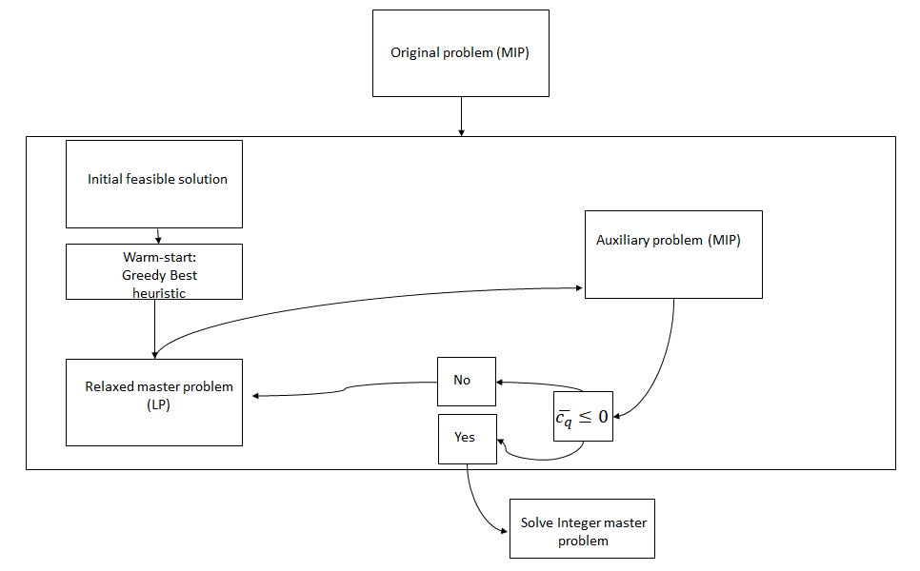
Solution scheme

Slide 15
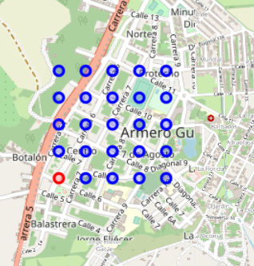
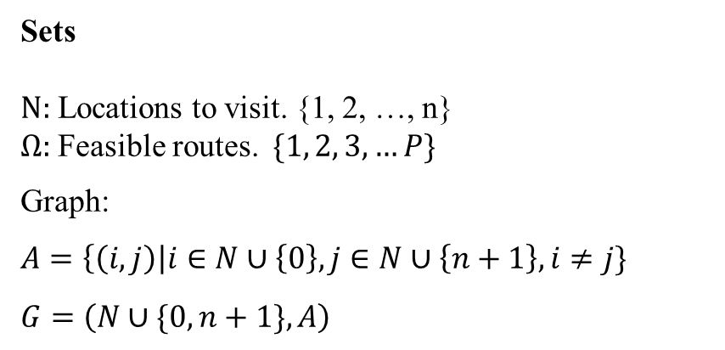
Nomenclature
Sets
$N:$ Locations to visit. {1, 2, …, n}
$Ω:$ Feasible routes. $\{1, 2, 3, …P\}$
Graph:
$A=\left\{\left(i,j\right)\right|i∈N∪\left\{0\right\}, j∈N∪\left\{n+1\right\}, i≠j\}$
$G=\left(N∪\{0, n+1\},A\right)$

Slide 16
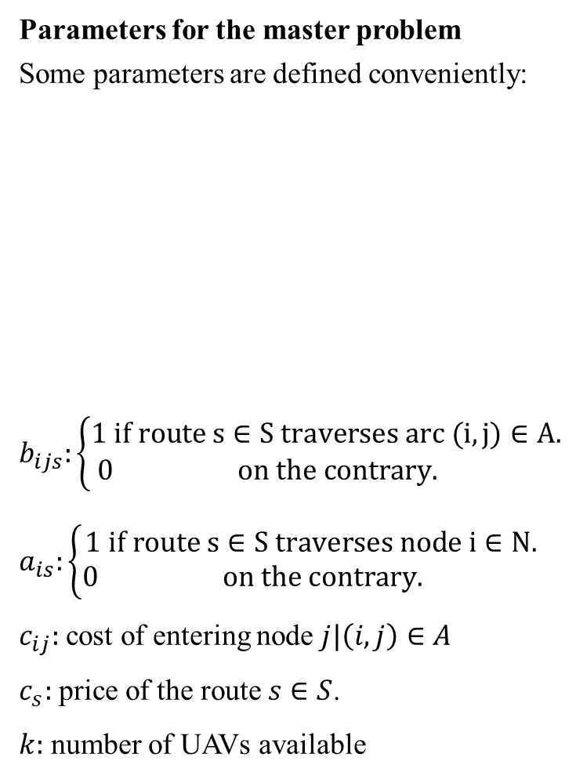
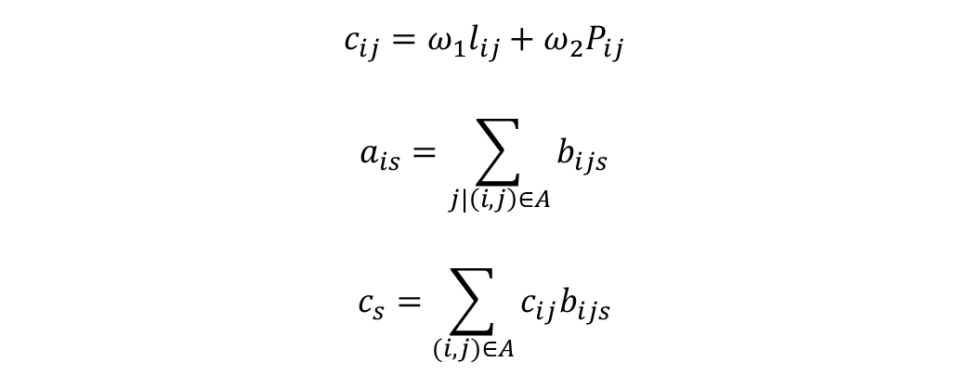
Nomenclature
Parameters for the master problem
Some parameters are defined conveniently:
$b_{ijs}:\left\{\begin{aligned}1 if route s∈S traverses arc (i,j)∈A. \\ 0 on the contrary. \end{aligned}\right.$
$a_{is}:\left\{\begin{aligned}1 if route s∈S traverses node i∈N. \\ 0 on the contrary. \end{aligned}\right.$
$c_{ij}:$ cost of entering node $j|\left(i,j\right)∈A$
$c_{s}:$ price of the route $s∈S$.
$k:$ number of UAVs available
$${c_{ij}=ω}_{1}l_{ij}+ω_{2}P_{ij}$$
$$a_{is}=\sum_{j|\left(i,j\right)∈A}{b_{ijs}}$$
$$c_{s}=\sum_{(i,j)∈A}{{c_{ij}b}_{ijs}}$$

Slide 17
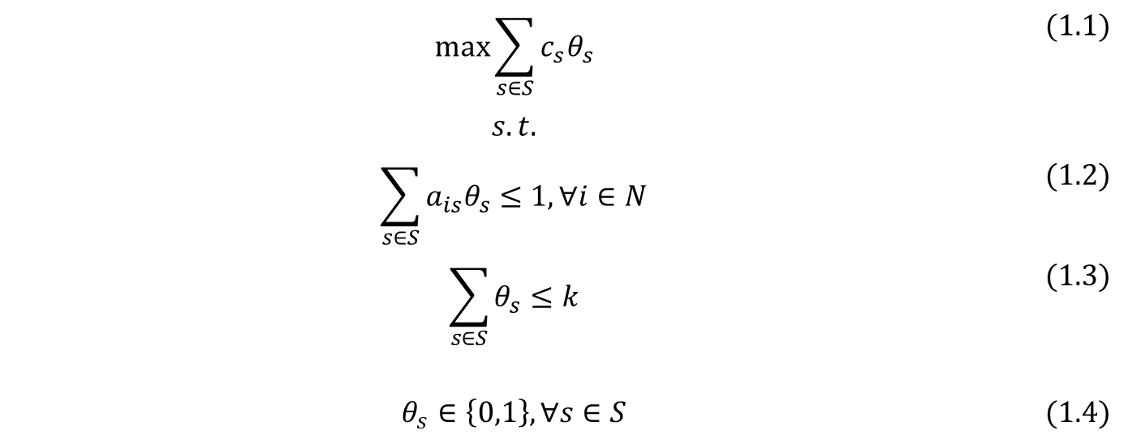
Master Problem defined as the knapsack problem
$$\max{\sum_{s∈S}{c_{s}θ_{s}}}$$ | $$(1.1)$$
$$s.t.$$
$$\sum_{s∈S}{a_{is}θ_{s}}≤1, ∀i∈N$$ | $$(1.2)$$
$$\sum_{s∈S}{θ_{s}}≤k$$ | $$(1.3)$$
$$θ_{s}∈\left\{0,1\right\}, ∀s∈S$$ | $$(1.4)$$
Every node is traversed at most one time
Maximum number of UAVs
Variables definitions

Slide 18
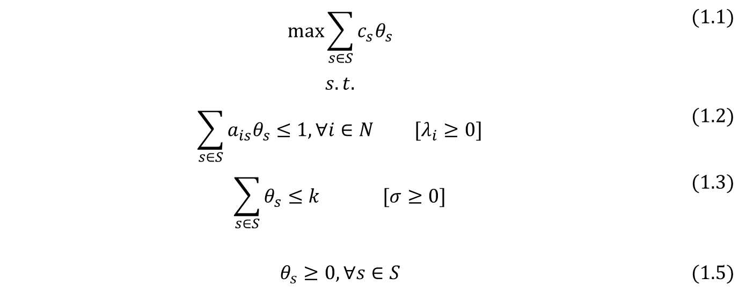
Relaxed Master Problem
$$\max{\sum_{s∈S}{c_{s}θ_{s}}}$$ | $$(1.1)$$
$$s.t.$$
$$\sum_{s∈S}{a_{is}θ_{s}}≤1, ∀i∈N [λ_{i}≥0]$$ | $$(1.2)$$
$$\sum_{s∈S}{θ_{s}}≤k [σ≥0]$$ | $$(1.3)$$
$$θ_{s}≥0, ∀s∈S$$ | $$(1.5)$$
Consists on relaxing the binary constraints
We retrieve the dual variables to compute the reduced costs in every iteration

Slide 19
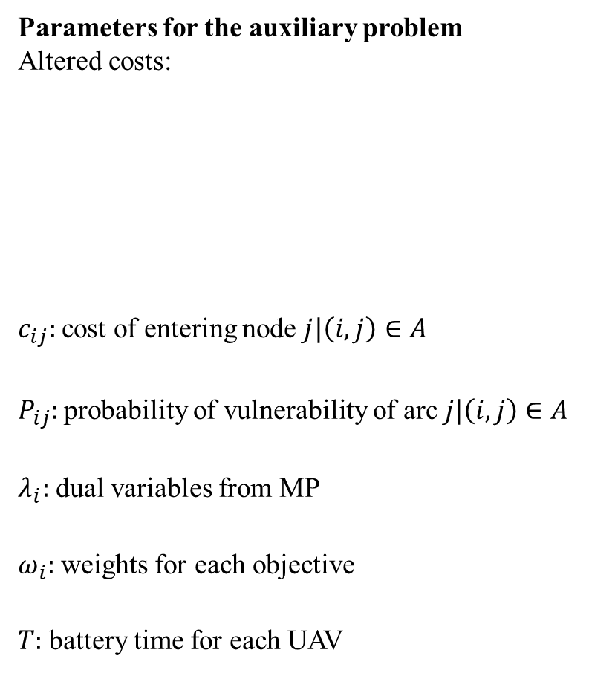
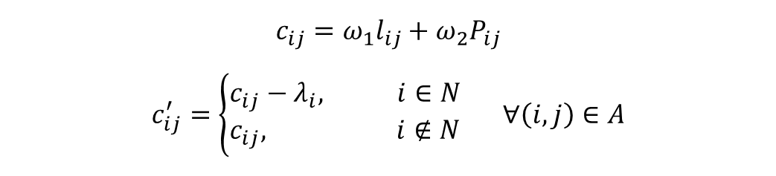
Nomenclature
Parameters for the auxiliary problem
Altered costs:
$c_{ij}:$ cost of entering node $j|\left(i,j\right)∈A$
$P_{ij}:$ probability of vulnerability of arc $j|\left(i,j\right)∈A$
$λ_{i}:$ dual variables from MP
$ω_{i}:$ weights for each objective
$T:$ battery time for each UAV
$${c_{ij}=ω}_{1}l_{ij}+ω_{2}P_{ij}$$
$$c_{ij}^{′}=\left\{\begin{aligned}c_{ij}−λ_{i}, i∈N \\ c_{ij}, i∉N\end{aligned}\right. ∀\left(i,j\right)∈A$$

Slide 20
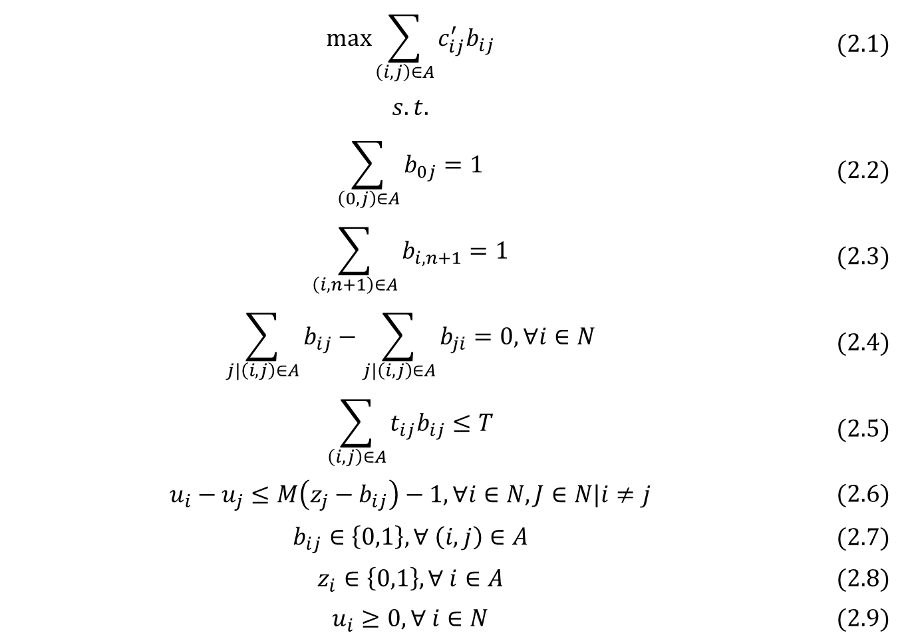
AP defined as the longest-path with resource constraints problem
$$\max{\sum_{\left(i,j\right)∈A}{c_{ij}^{′}b_{ij}}}$$ | $$(2.1)$$
$$s.t.$$
$$\sum_{\left(0,j\right)∈A}{b_{0j}}=1$$ | $$(2.2)$$
$$\sum_{\left(i,n+1\right)∈A}{b_{i,n+1}}=1$$ | $$(2.3)$$
$$\sum_{j|\left(i,j\right)∈A}{b_{ij}}−\sum_{j|\left(i,j\right)∈A}{b_{ji}}=0, ∀i∈N$$ | $$(2.4)$$
$$\sum_{\left(i,j\right)∈A}{t_{ij}b_{ij}}≤T$$ | $$(2.5)$$
$$u_{i}−u_{j}≤M\left(z_{j}−b_{ij}\right)−1, ∀i∈N,J∈N|i≠j$$ | $$(2.6)$$
$$b_{ij}∈\left\{0,1\right\}, ∀ \left(i,j\right)∈A$$ | $$(2.7)$$
$$z_{i}∈\left\{0,1\right\}, ∀ i∈A$$ | $$(2.8)$$
$$u_{i}≥0, ∀ i∈N$$ | $$(2.9)$$
Flow constraints
Resource constraint
Subtours constraints
Variables definitions

Slide 21
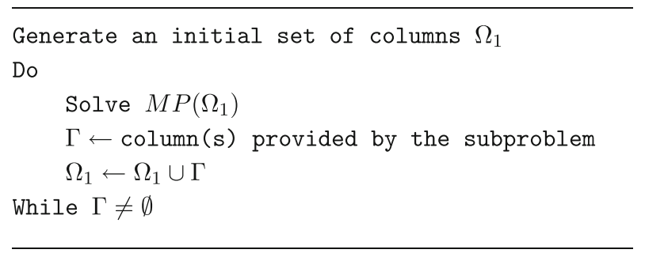
Column Generation procedure
Fig 1. Column Generation pseudo-code
Feillet, D. A tutorial on column generation and branch-and-price for vehicle routing problems. 4OR-Q J Oper Res 8, 407–424 (2010). https://doi.org/10.1007/s10288-010-0130-z

Slide 22
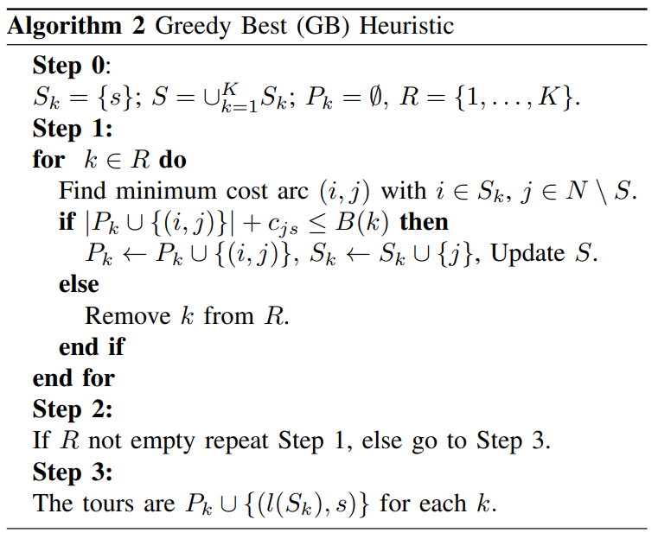
Column Generation enhancement with warm-start
Fig 2. Greedy Best heuristic pseudo-code
A. Anastasiou, P. Kolios, C. Panayiotou and K. Papadaki, "Swarm Path Planning for the Deployment of Drones in Emergency Response Missions," 2020 International Conference on Unmanned Aircraft Systems (ICUAS), Athens, Greece, 2020, pp. 456-465, doi: 10.1109/ICUAS48674.2020.9213876.

Slide 23
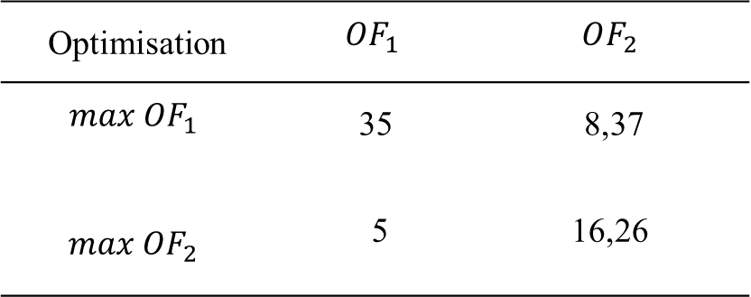
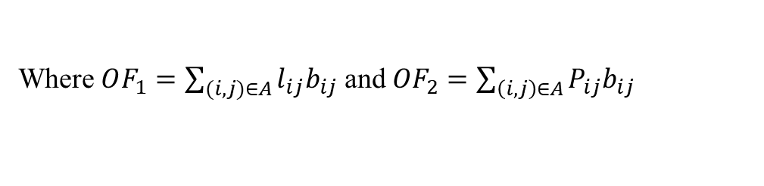
Pareto front procedure
Optimisation | $$OF_{1}$$ | $$OF_{2}$$
$$max OF_{1}$$ | 35 | 8,37
$$max OF_{2}$$ | 5 | 16,26
Table 1. Payoff table for both objectives
Where $OF_{1}=\sum_{(i,j)∈A}{l_{ij}b_{ij}}$ and $OF_{2}=\sum_{\left(i,j\right)∈A}{P_{ij}b_{ij}}$
George Mavrotas, Effective implementation of the ε-constraint method in Multi-Objective Mathematical Programming problems, Applied Mathematics and Computation, Volume 213, Issue 2, 2009, Pages 455-465, ISSN 0096-3003, https://doi.org/10.1016/j.amc.2009.03.037.

Slide 24

Pareto front procedure
Now, with the payoff table computed, the optimisation problem to build the Pareto front consisted of making one of the objectives as a constraint, Equations (2.2)-(2.11) formulate the iterative process to compute the Pareto front.
$$\max{OF_{1}+(β/r)SV}$$ | $$(2.10)$$
$$OF_{2}−SV=ε$$ | $$(2.11)$$
Where β is a small number between ${10}^{−3}$ and ${10}^{−6}$, SV is a slack variable, r is the range of $OF_{2}$ and ϵ is calculated each iteration by:
$$ε=\underline{OF_{2}}+δ$$ | $$(2.12)$$
Being δ a step, and $\underline{OF_{2}}$ is the minimum value for $OF_{2}$. This is a process of reoptimising every time the parameter ϵ is updated on each iteration.

Slide 25
Agenda
Mathematical models
Objectives
Column Generation approach
Q-Learning approach
Notes:
Geohash

Slide 26
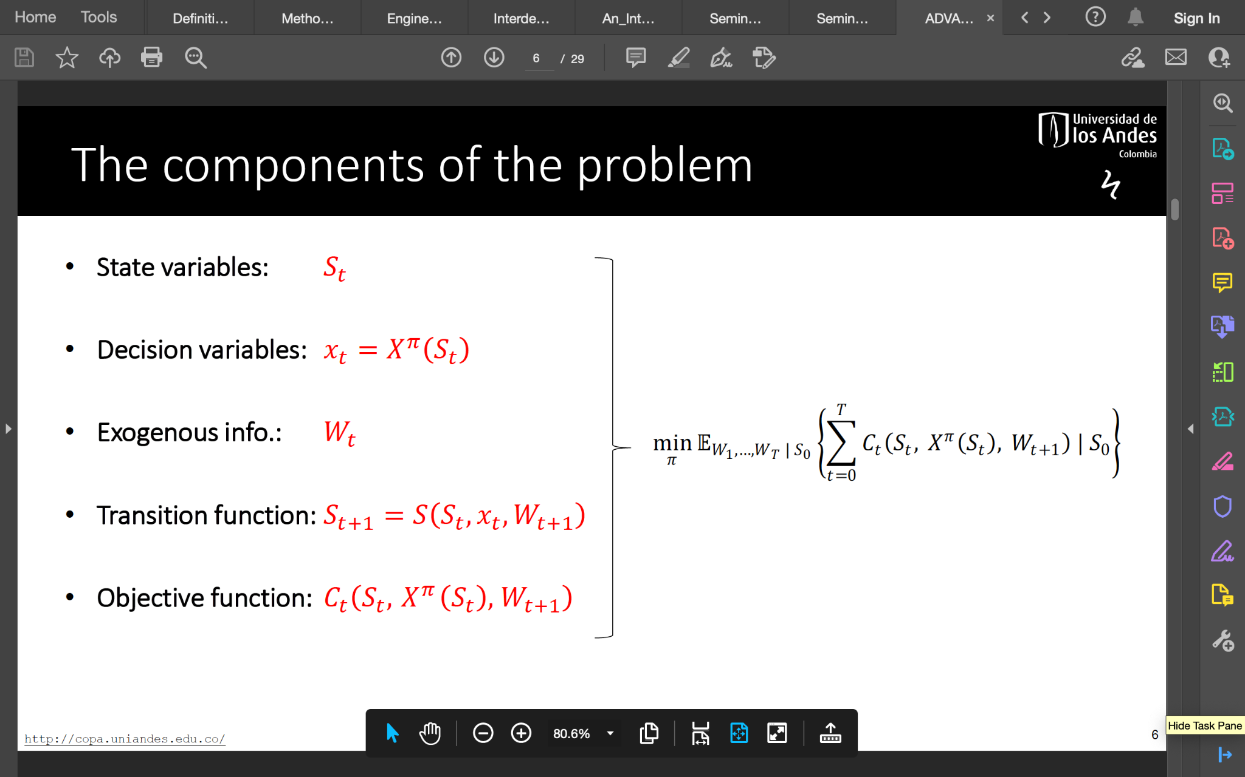
Framework for Stochastic Optimisation
Notes:
Es parecido a un MDP pero sirve para otros approaches

Slide 27
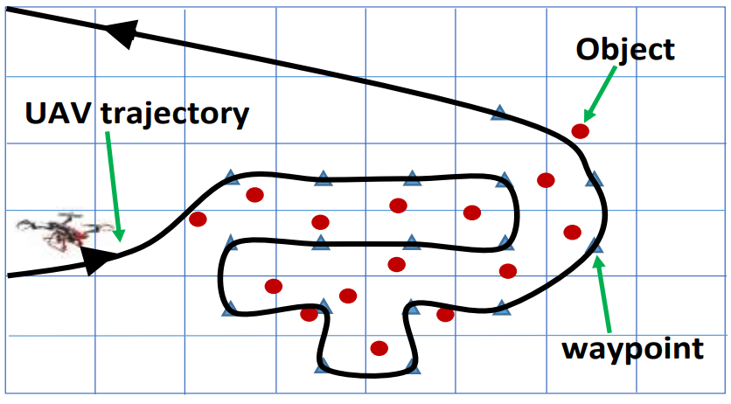
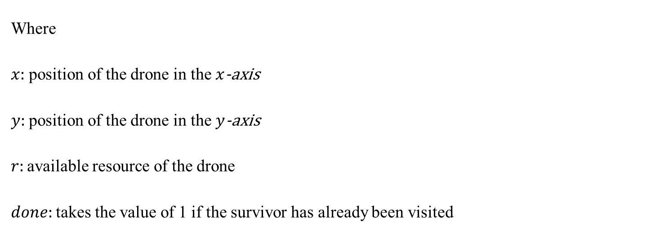
State space for the problem
$$S_{t}=\left(x,y,r,done\right)$$
Where
$x:$ position of the drone in the $x$-axis
$y:$ position of the drone in the $y$-axis
$r:$ available resource of the drone
$done:$ takes the value of 1 if the survivor has already been visited
Notes:
Es parecido a un MDP pero sirve para otros approaches

Slide 28

Available drone’s actions
$$X_{t}=\left\{x,y, r\right\}$$
Where
$x:$ move in the $x$-axis
$y:$ move in the $y$-axis
$r:$ assign resource
Notes:
Es parecido a un MDP pero sirve para otros approaches

Slide 29
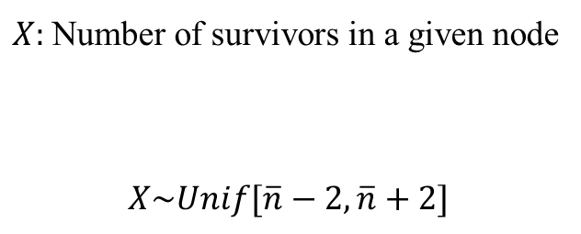
Uncertainty in the number of survivors
$$W=\left\{Real number of survivors\right\}$$
$X:$ Number of survivors in a given node
$$X\sim Unif[\overline{n}−2,\overline{n}+2]$$
Notes:
Es parecido a un MDP pero sirve para otros approaches

Slide 30
Rewards and penalties for the agent
$$R_{t}\left(S_{t},W_{t},S_{t+1}\right)$$
$$\max{R_{t}}$$
Move penalty: -5
Station reward: 200
Battery penalty: -300
Survivor already visited: -n
Survivor visit: n
Notes:
Es parecido a un MDP pero sirve para otros approaches

Slide 31
Q-Learning algorithm
Reinforcement Learning Algorithm
Exploration on the environment and exploitation of recollected information
Estimation of a Q-table which is updated on every episode
$$Q\left(S,A\right)←Q\left(S,A\right)+α\left(R+γ\max_{a}{Q\left(S^{′},a \right)}−Q\left(S,A\right)\right)$$
Notes:
Model free algorithm this means that the agent doesnt need to know the set of parameters but trough exploration it Will learn from the env.

Slide 32
Agenda
Motivation
Mathematical models
Objectives
Nomenclature
Parameters
Column Generation approach
Q-Learning approach
Computational experiments
Conclusions and future work
Notes:
GUIOON

Slide 33
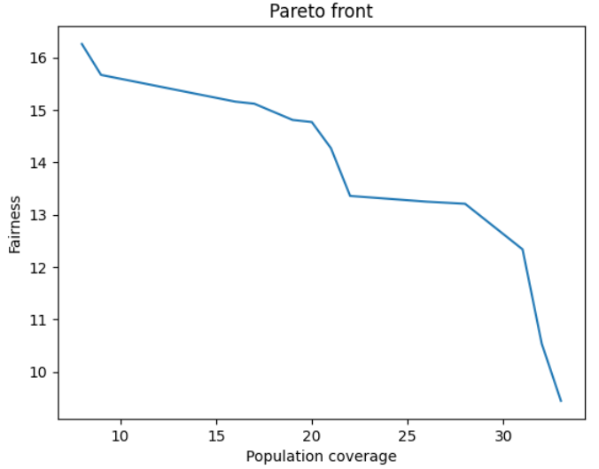
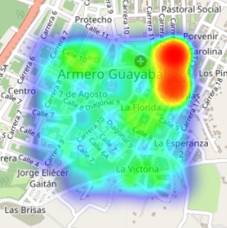
Pareto front for a small instance and instance generation
The instance has been generated conveniently so the fairness is away from the depot and the population is nearer the depot

Slide 34
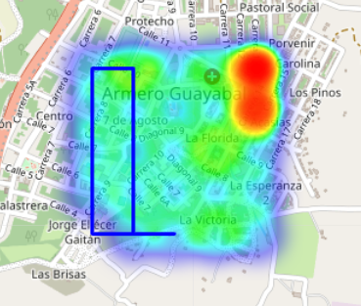
Initial solution provided by heuristic

Slide 35
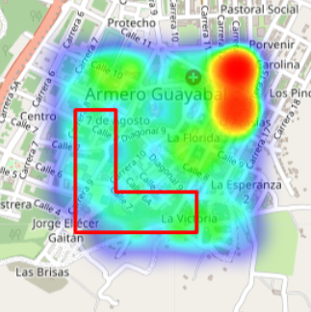
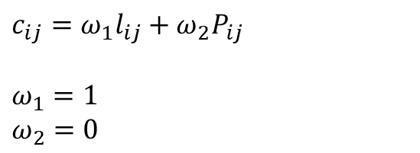
Optimising on population coverage
$c_{ij}=ω_{1}l_{ij}+ω_{2}P_{ij}$
$ω_{1}=1$
$ω_{2}=0$

Slide 36
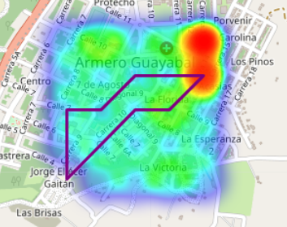
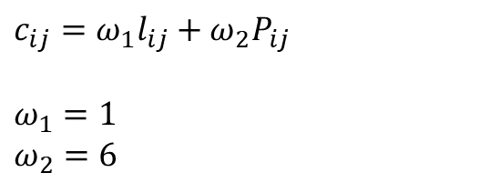
Optimising on mid-point
$c_{ij}=ω_{1}l_{ij}+ω_{2}P_{ij}$
$ω_{1}=1$
$ω_{2}=6$

Slide 37
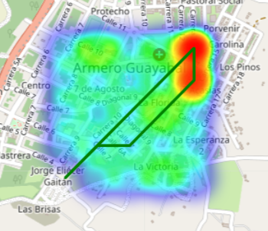
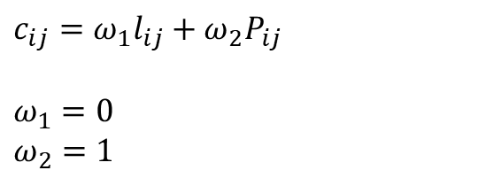
Optimising on fairness
$c_{ij}=ω_{1}l_{ij}+ω_{2}P_{ij}$
$ω_{1}=0$
$ω_{2}=1$

Slide 38
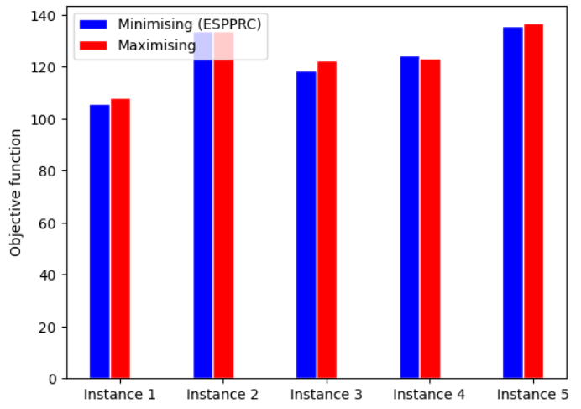
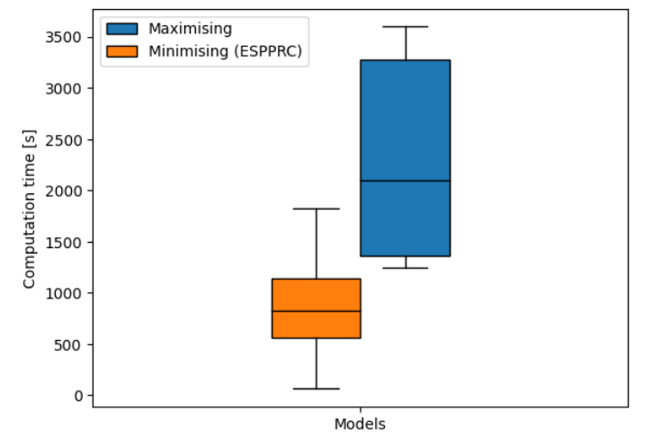

Computation time comparison with the new Elementary Shortest Path Problem With Resource Constraints (ESPPRC)
$$\max{\sum_{\left(i,j\right)∈A}{c_{ij}^{′}b_{ij}}}$$
$$\min{\sum_{\left(i,j\right)∈A}{−c_{ij}^{′}b_{ij}}}$$
All the results were run in processor Intel(R) Core (TM) i5-8250U CPU @ 1.60GHz 1.80 GHz, RAM 8,00 GB (7,86 GB usable) in type 64-bit operating system, x64-based processor in Gurobi optimiser under version 10,0 and academic license

Slide 39
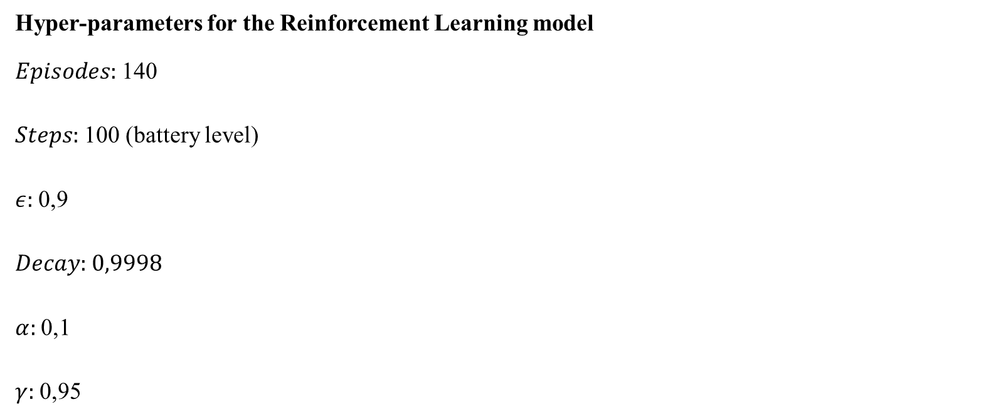
Parameters
Hyper-parameters for the Reinforcement Learning model
$Episodes:$ 140
$Steps:$ 100 (battery level)
$ε:$ 0,9
$Decay:$ 0,9998
$α:$ 0,1
$γ:$ 0,95

Slide 40
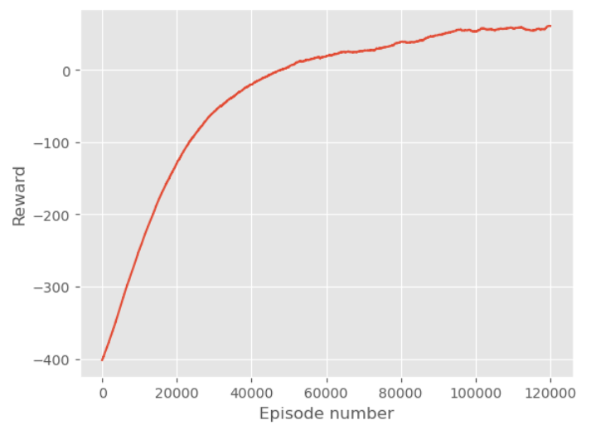
Learning curve of q-learning
Notes:
Es parecido a un MDP pero sirve para otros approaches

Slide 41
Agenda
Motivation
Mathematical models
Objectives
Nomenclature
Parameters
Column Generation approach
Q-Learning approach
Computational experiments
Conclusions and future work

Slide 42
Conclusions
The Column Generation approach using a warm start shows an improvement throughout the iterations
We showed a trade-off between fairness and population in an emergency response situation

Slide 43
Future Work
Properly quantify fairness and include metrics to compare the results depending on the metric
Accelerate the Auxiliary Problem using the Pulse algorithm and adding more feasible and attractive routes

Slide 44


Questions?
gr.pardo@uniandes.edu.co
https://copa.uniandes.edu.co/

